Slide 1


CS221: Introduction to Artificial Intelligence

Slide 2
http://cs221.stanford.edu/

Slide 3

Candy Policy

Slide 4
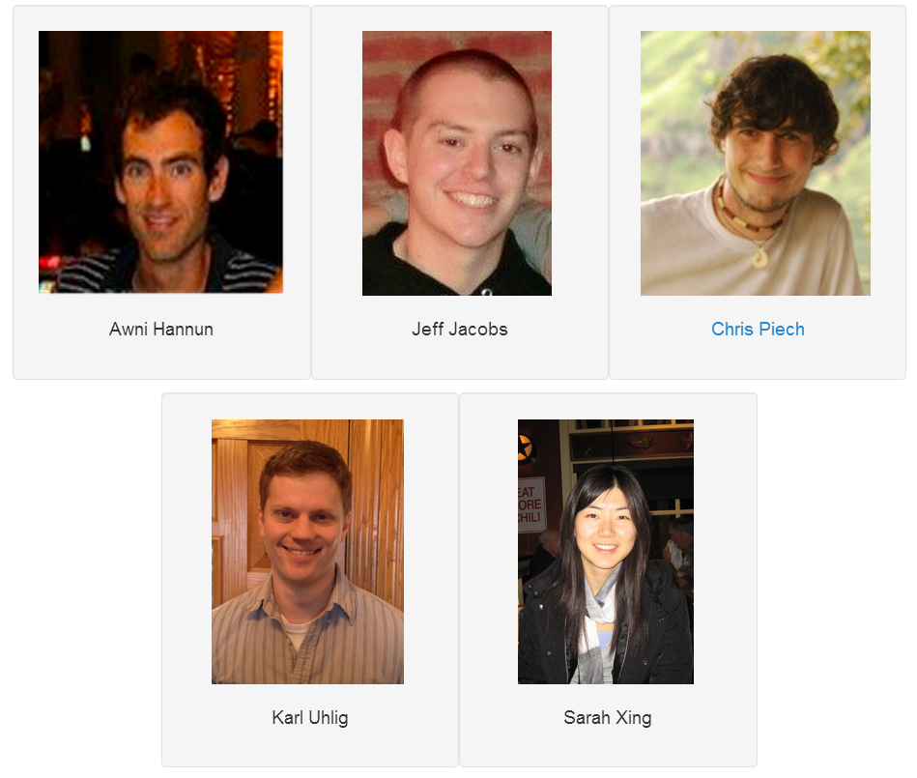
CS221 Staff
Get to know us!

Slide 5
Right Course?
Maths of Computing (CS103)
Programming (CS106)
Probability

Slide 6

Summertime?

Slide 7
Due Dates
Due at 11:59P.M.
Three free “late days”
Extensions approved by Chris.

Slide 8


Grading Scale
Homework and problem set grades for the assignments use the following scale:
A submission so good it “makes you weep.”
Exceeds requirements.
Satisfies all requirements of the assignment.
Meets most requirements, but with some problems.
Has more serious problems.
Is even worse than that.
Why did you turn this in?

Slide 9
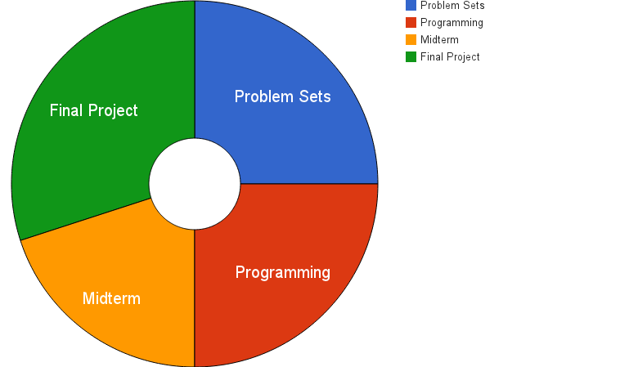
Grade Breakdown

Slide 10

Ask Questions!
Post to Piazza
Email cs221-sum1213-staff@lists.stanford.edu

Slide 11
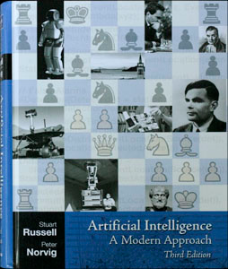
Book
$78
Prime

Slide 12
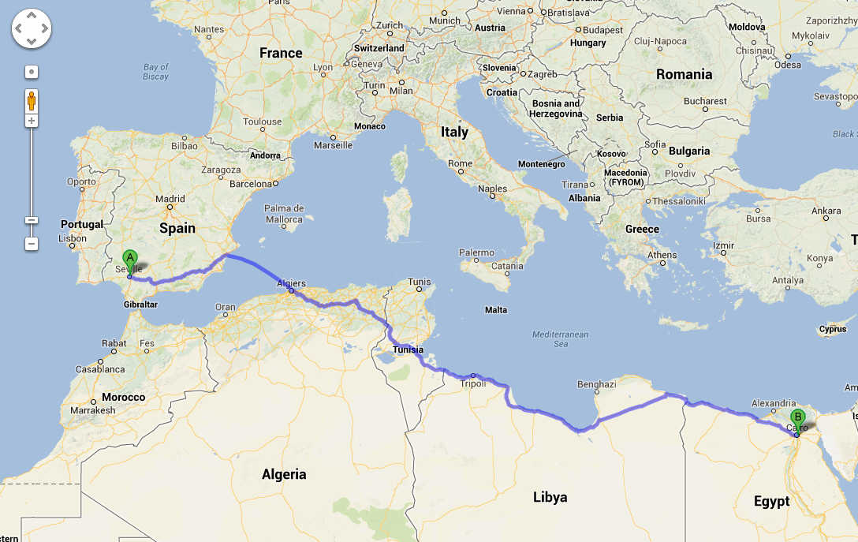
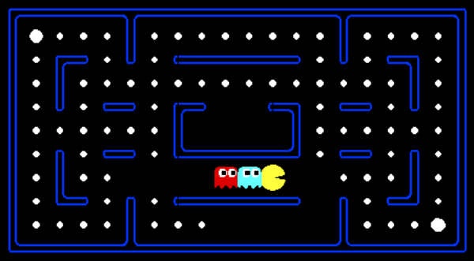
Homework 1
Due July 8th
Python review Friday 2:15 to 3:05pm in Gates B01

Slide 13
Honor Code Rules
Rule 1:
You must indicate on your submission any assistance you received.
Rule 2:
You must not share actual program code or problem solutions with other students.
Rule 3:
You must not look at solutions posted on the web or from other years.
Rule 4:
You must be prepared to explain any homework you submit.

Slide 14
What is AI?

Slide 15
[suspense]

Slide 16
AI: The study and design of intelligent agents

Slide 17

Volunteer

Slide 18
AI: The study and design of intelligent agents

Slide 19
Computer
programs
AI: The study and design of intelligent agents
Better than
chance
As well as
humans

Slide 20
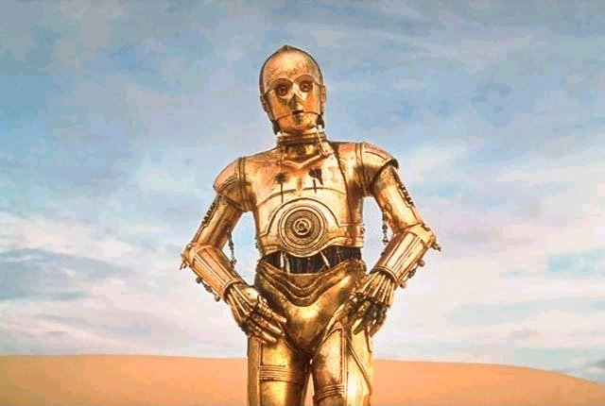
A Brief History

Slide 21
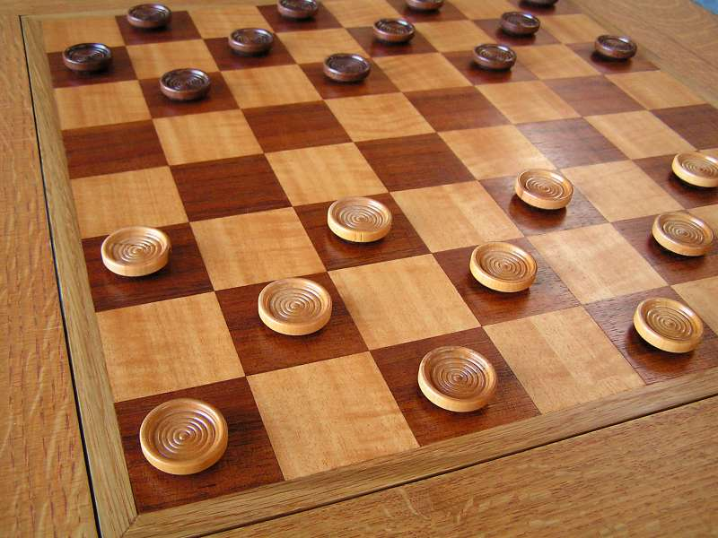
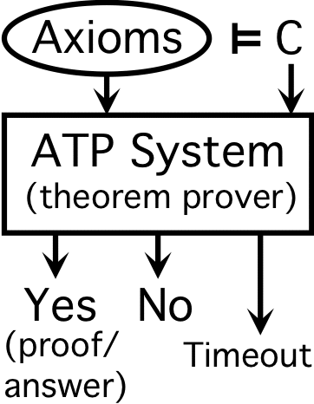
Early Optimism (1950s)
1952
1955

Slide 22
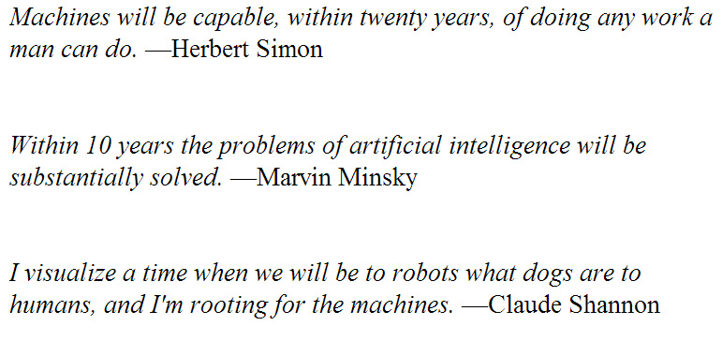
Early Optimism (1950s)

Slide 23
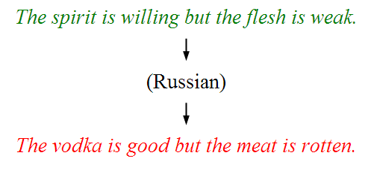
Underwhelming Results (1950 to 90s)
Problem space grew too quickly
Complexity of the world made it hard to encode all rules

Slide 24

Data Revolution (1990s)
Use data to learn from experience
Model Uncertainty

Slide 25



Big Milestones
1997 Deep Blue
2005 Stanley
2011 Watson

Slide 26


Exciting Times!

Slide 27
CS221
Search
Machine Learning
Variable Based

Slide 28
Course Goals
Reason about goals: what will I get if I try this sequence of actions?
Deal with uncertainty: don't know what will happen, ambiguity in language, noise in sensor readings
Learn from experience: results of actions provide information to improve utility over time
Solve real problems: formalize real life challenges and know a few tools to solve formalized problems.

Slide 29
The AI Pipeline
Real World Problem
Model the problem
Formal Problem
Apply an Algorithm
Evaluate
Solution

Slide 30

Ready to dive in?

Slide 31
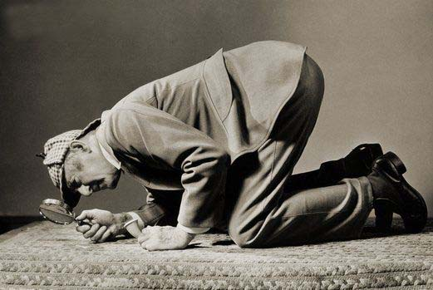
Searching:
Using AI algorithms to find solutions for you.

Slide 32

DNA Alignment
ATTGGGAAATGCCCCATTATTBBC
ATTGGAATCGACATATTATTBBC

Slide 33
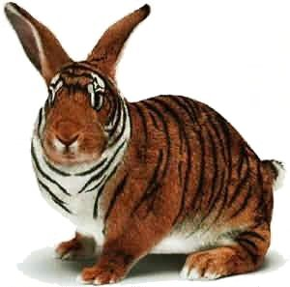
DNA Alignment

Slide 34
CS221
Search
Machine Learning
Variable Based

Slide 35
CS221
Search
Model how to make decisions. Have an algorithm learn which decision(s) can lead to a “solution”

Slide 36


Slide 37

Determ. State Problems
Model
Solvers

Slide 38
Determ. State Problems
Model
Solvers

Slide 39


Deterministic State Problems
No Uncertainty
Discretized

Slide 40
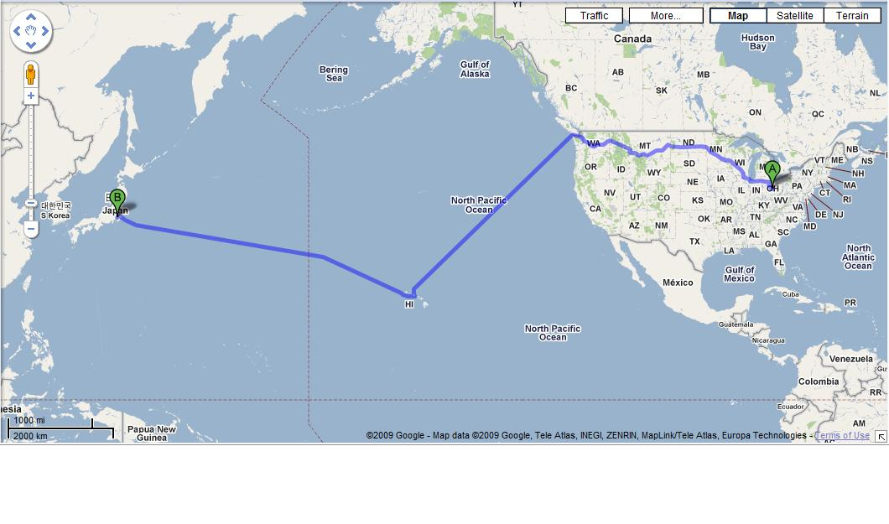


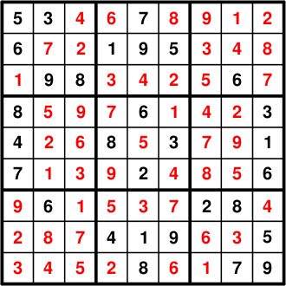
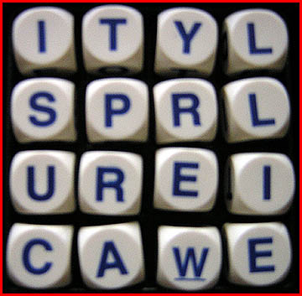
Deterministic State Problems

Slide 41
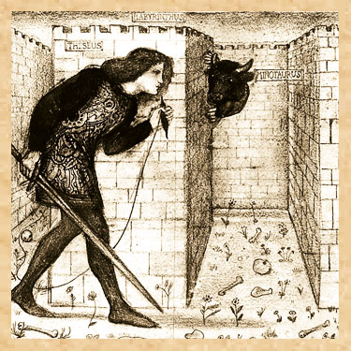
Maze

Slide 42

Maze
Θ

Slide 43

Maze == Ghost Algorithm

Slide 44
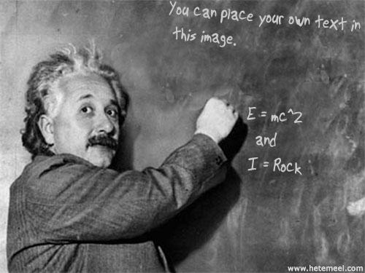

Slide 45
Determ. State Problems
Model
Solvers

Slide 46
Determ. State Problems
Model
Solvers

Slide 47
The AI Pipeline
Real World Problem
Model the problem
Formal Problem
Apply an Algorithm
Evaluate
Solution

Slide 48
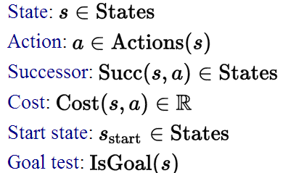
Deterministic State Space Models

Slide 49
State
A state contains all information that is
Not – constant
Relevant to the task

Slide 50

State
Position
Direction
Position of other Airplanes
PI (3.14)
Price of gold

Slide 51

Intuition

Slide 52
Intuition
Describe how a computer
can try everything

Slide 53

Intermission
http://vimeo.com/65042779

Slide 54

Spell Checking

Slide 55
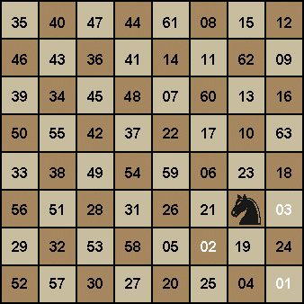
Knight’s Tour
Knight's Tour Demo

Slide 56
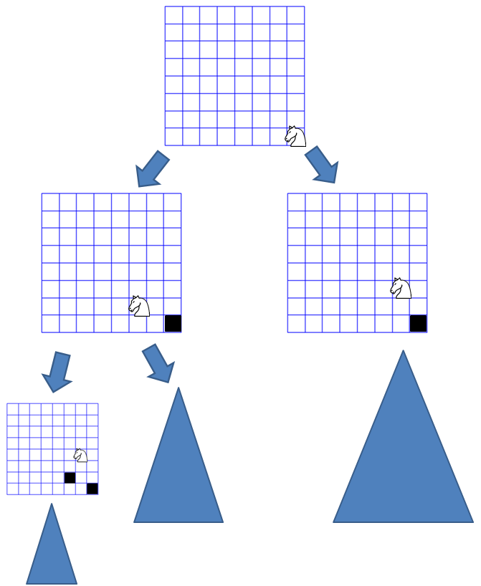
Knight’s Tour

Slide 57
Determ. State Problems
Model
Solvers

Slide 58
Determ. State Problems
Model
Solvers

Slide 59
The AI Pipeline
Real World Problem
Model the problem
Formal Problem
Apply an Algorithm
Evaluate
Solution

Slide 60
Exploration Algorithm
Start
Goal

Slide 61
Breadth First Search
Insight: Keep a queue of states to visit

Slide 62
Breadth First Search
queue = Queue()
queue.enqueue(startState)
visited = Set([])
while !queue.isEmpty():
currState = queue.dequeue()
if not currState in visited:
if isTerminal(currState) return currState
for nextState in getNextStates(currState) queue.enqueue(nextState)
}
}
}

Slide 63

Breadth First Search
queue = Queue()
queue.enqueue(startState)
visited = Set([])
while !queue.isEmpty():
currState = queue.dequeue()
if not currState in visited:
if isTerminal(currState) return currState
for nextState in getNextStates(currState) queue.enqueue(nextState)
}
}
}

Slide 64
Breadth First Search
queue = Queue()
queue.enqueue(startState)
visited = Set([])
while !queue.isEmpty():
currState = queue.dequeue()
if not currState in visited:
if isTerminal(currState) return currState
for nextState in getNextStates(currState) queue.enqueue(nextState)
}
}
}

Slide 65
Breadth First Search
Enqueue the start state

Slide 66
Breadth First Search
Dequeue the first state

Slide 67
Breadth First Search
Check if it’s the goal or if it has been visited

Slide 68
Breadth First Search
Find each successor state

Slide 69
Breadth First Search
Front
Back
Find each successor state

Slide 70
Breadth First Search
Find each successor state

Slide 71
Hashing
Breadth First Search
Enqueue the successor states

Slide 72
Hashing
Breadth First Search
Enqueue the successor states

Slide 73
Breadth First Search
Breadth First Search
Forget about the dequeued state

Slide 74
Breadth First Search
Breadth First Search
Back to the start of the while loop

Slide 75
Breadth First Search
Dequeue a state

Slide 76
Breadth First Search
Check if it’s a goal or if the state has been visited

Slide 77
Breadth First Search
Find each successor state

Slide 78
Breadth First Search
Enqueue each successor

Slide 79
Breadth First Search
Enqueue each successor

Slide 80
Breadth First Search
Back to the start of the while loop

Slide 81
Breadth First Search
Dequeue a path

Slide 82
Breadth First Search
Check if it’s a goal

Slide 83
Breadth First Search
queue = Queue()
queue.enqueue(startState)
visited = Set([])
while !queue.isEmpty():
currState = queue.dequeue()
if not currState in visited:
if isTerminal(currState) return currState
for nextState in getNextStates(currState) queue.enqueue(nextState)
}
}
}

Slide 84
Depth First Search
stack = Stack()
stack.push(startNode)
visited = Set([])
while !stack.isEmpty():
currState = stack.pop()
if not currState in visited:
if isTerminal(currState) return currState
for nextState in getNextStates(currState) stack.push(nextState)
}
}
}

Slide 85
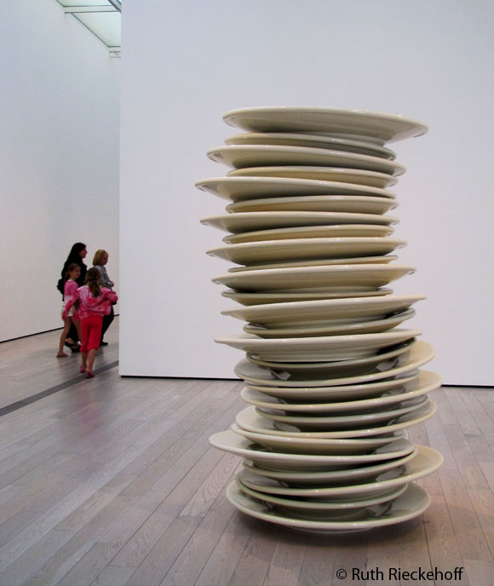

Stack vs Queue

Slide 86



Stacks
LIFO
push and pop
Dish metaphor

Slide 87
Depth First Search
Create an empty stack

Slide 88
Depth First Search
Push a path with just the start node

Slide 89
Depth First Search
Enter the while loop

Slide 90
Depth First Search
Pop a path

Slide 91
Depth First Search
Check if its been visited or if it’s the goal

Slide 92
Depth First Search
Create a path for each of its neighbors

Slide 93
Depth First Search
Bottom
Top
Create a path for each of its neighbors

Slide 94
Depth First Search
Create a path for each of its neighbors

Slide 95
Depth First Search
Push the new paths

Slide 96
Depth First Search
Push the new paths

Slide 97
Depth First Search
Back to the start of the while loop

Slide 98
Depth First Search
Bottom
Top
Back to the start of the while loop

Slide 99
Depth First Search
Pop a path

Slide 100
Depth First Search
Check if the last node is a goal or if its been visited

Slide 101
Depth First Search
Create a new path for each neighbor of the last node

Slide 102
Depth First Search
Push the new paths

Slide 103
Depth First Search
Push the new paths

Slide 104
Depth First Search
Back to the start of the while loop

Slide 105
Depth First Search
Pop a path

Slide 106
Depth First Search
Check if the last node is a goal or if its been visited

Slide 107
Depth First Search Pros
If you implement depth first search recursively it only has to store a single path in memory! BFS must store all states in the fringe.

Slide 108
Depth First Search Cons
Not guaranteed to find the lowest cost solution for all problems.
Can get lost.

Slide 109
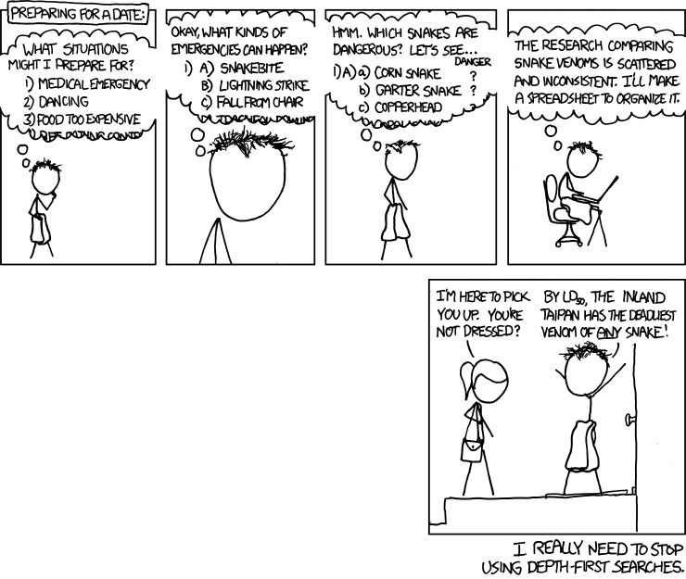

Slide 110
BFS vs DFS
Demo

Slide 111
DNA Alignment
ATTGGGAAATGCCCCATTATTBBC
ATTGGAATCGACATATTATTBBC

Slide 112
Can We Do It?

Slide 113


Slide 114

We Broke BFS

Slide 115


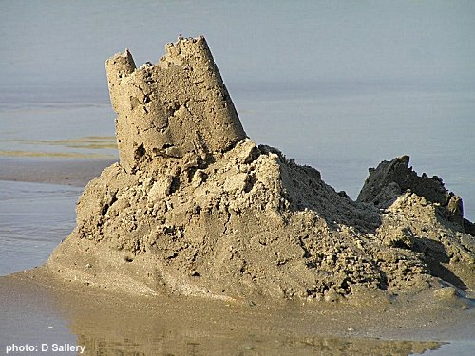
Why AI?

Slide 116

Why AI?

Slide 117
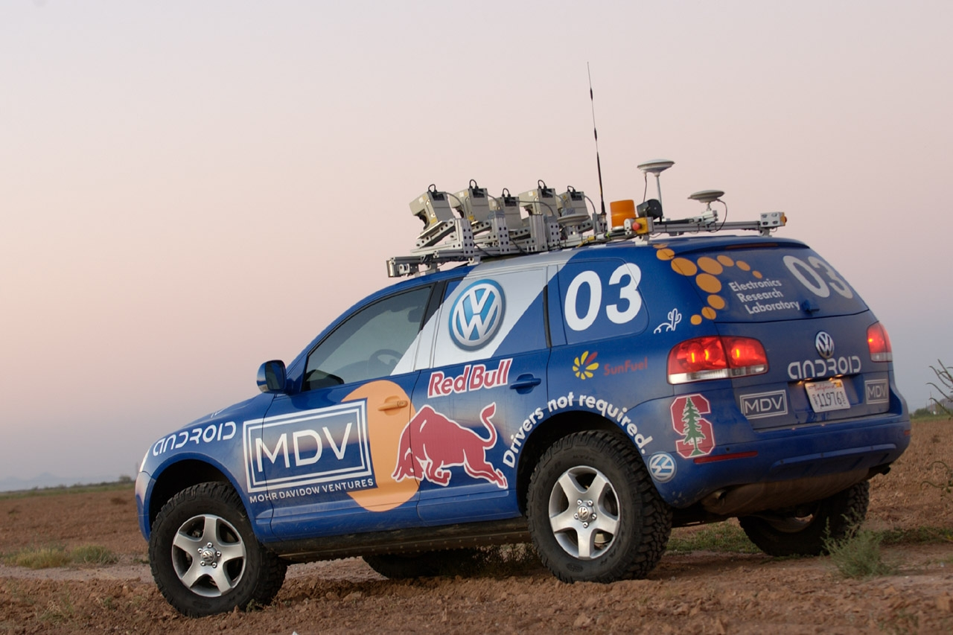

Why AI?

Slide 118

Why AI?

Slide 119
Determ. State Problems
Model
Solvers

Slide 120
Computer
programs
AI: The study and design of intelligent agents
Better than
chance
As well as
humans

Slide 121
The End.

Slide 122

The End?

